Slide 1
Floor Cleaning Bot

Slide 2
Aim/ Objective
While cleaning, getting to the little unreachable spaces under the beds, tables, and sofas can be a big issue. Through small but smart vacuum cleaners are now out there, but they are too expensive for what they do. So, the aim is to make a floor cleaning robot that only costs a small fraction of the ones in the market.
This robot can mop the floor and continue moving, avoiding the obstacles, until the whole room is cleaned by few taps on the smartphone.

Slide 3
Implementation
For this project we are using Arduino UNO R3 ATmega328P as the microprocessor which controls and send the signals received from the Bluetooth module.
For the Bluetooth module we are using HC 05 wireless Rf transceiver.
To control the wheel motor L239D motor driver is used. It can control up to 2 motors at once. Its controllable by 5V supply which is provided from Arduino.
The operating voltage of motor is in between 3V to 12V DC.

Slide 4
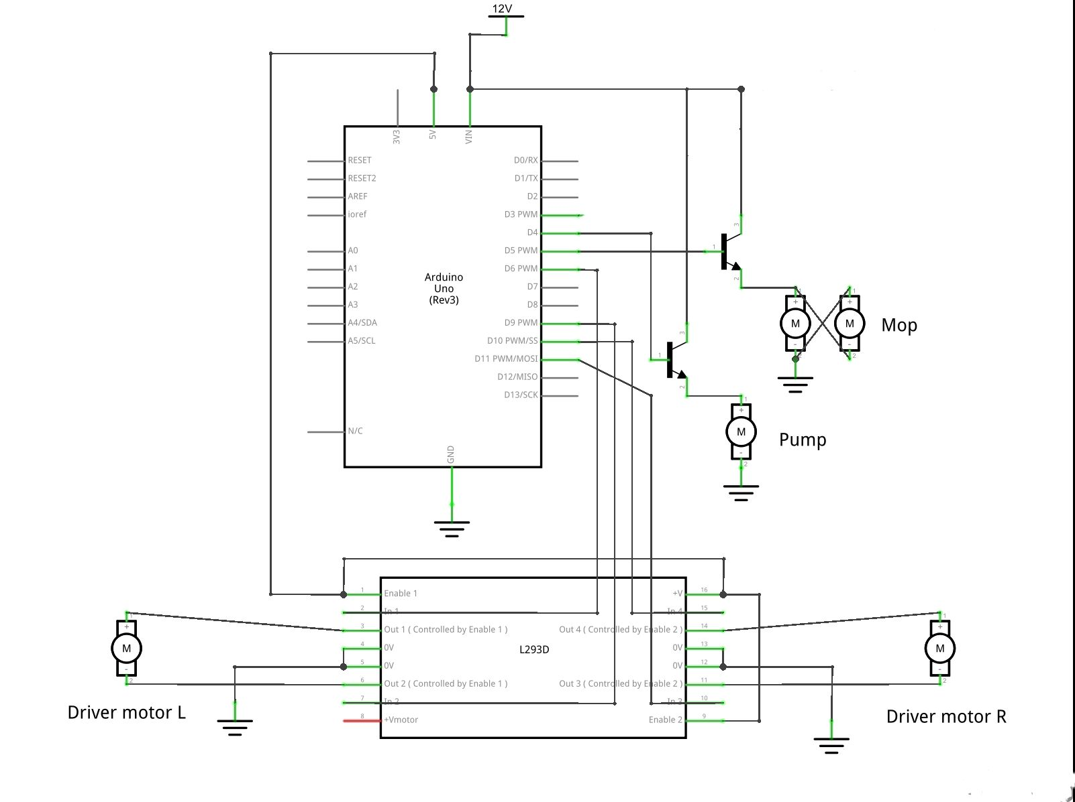
Circuit Diagram

Slide 5
Working
The Arduino receives signal from Bluetooth module HC-05 through Rx pin. The signal is then sent to the pin for which the command is sent.
Say, the Bluetooth module HC-05 sends the command to turn Pump motor on. The signal is received by the Arduino through Rx signal and then Arduino sends the command to pin D4 which sends the signal to the base of transistor to turn the motor ON. The transistor acts as a switch.

Slide 6
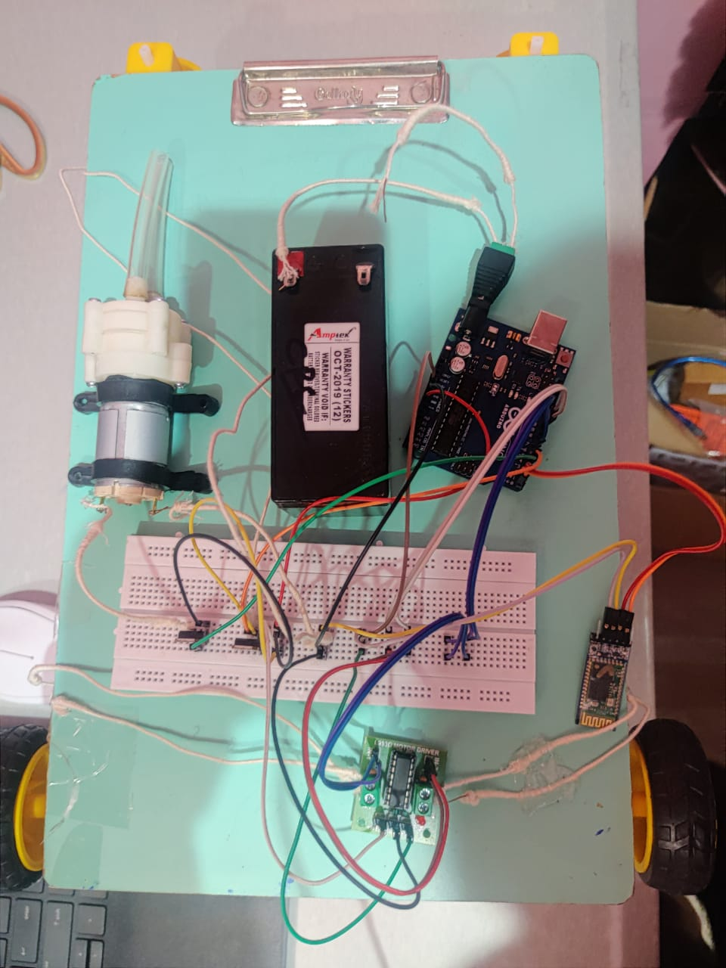
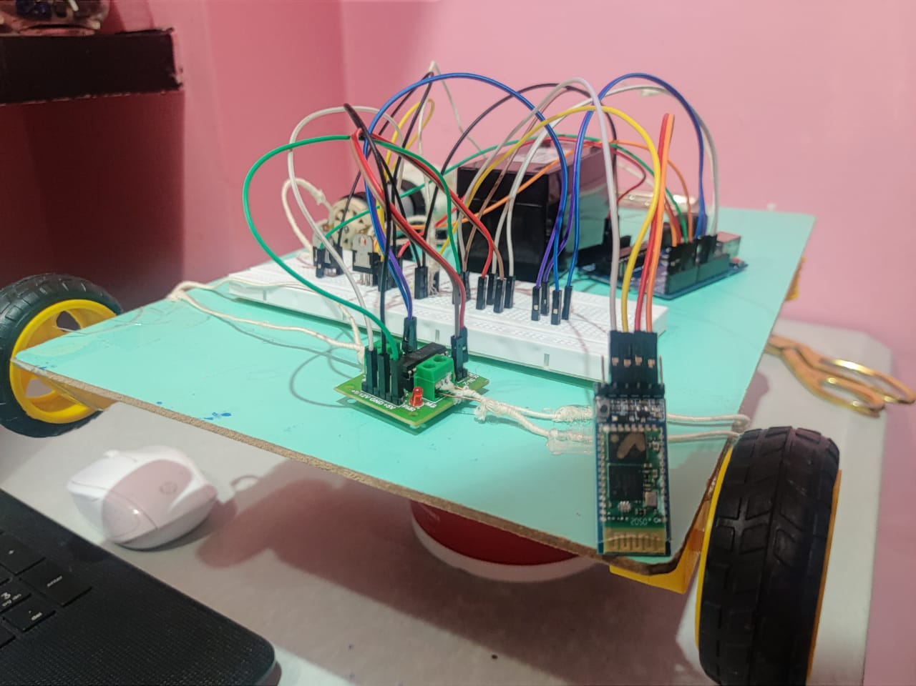
Result

Slide 7
References
[1] Components101. 2021. HC-05 Bluetooth Module Pinout, Specifications, Default Settings, Replacements & Datasheet. [online] Available at: <https://components101.com/wireless/hc-05-bluetooth-module> [Accessed 3 June 2021].
[2] Arduino Uno Rev3. Arduino Uno Rev3 | Arduino Official Store. (n.d.). https://store.arduino.cc/usa/arduino-uno-rev3.
[3] Components101. 2021. TIP122 Transistor Pinout, Features, Equivalent & Datasheet. [online] Available at: <https://components101.com/transistors/tip122-pinout-equivalent-datasheet> [Accessed 4 June 2021].
[4] Shah, Vatsal. (2015). Floor Cleaning Robot with Mobile-App or Autonomous. 10.13140/RG.2.1.4565.9288.

Slide 8
THANK YOU

